Slide 1
Local Explanation of Dialogue Response Generation
Shao Wei

Slide 2
Motivation and Key Points
Explain the reasoning process of a generation model
Explanation Form
The mutual interaction of segments in input and output sentences (Matrix)
Explain a trained model on ground truth instead of generated results
Creates explanations by perturbing the input and calculating the certainty change over the human response
Evaluate the method on metrics including necessity, sufficiency and User study

Slide 3
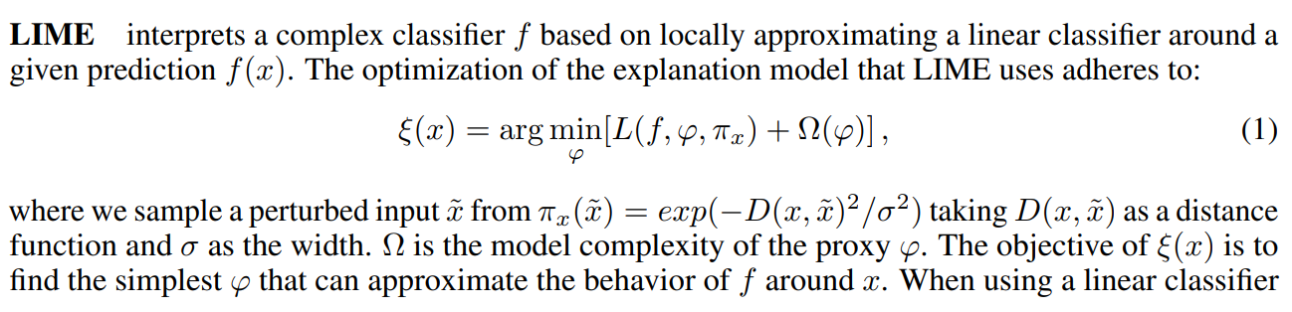
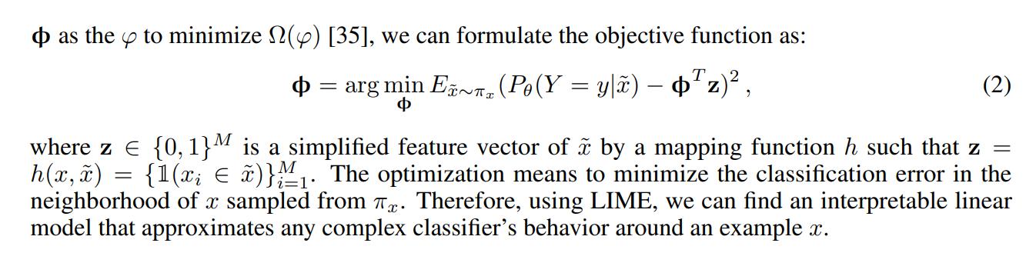
Local Explanation

Slide 4
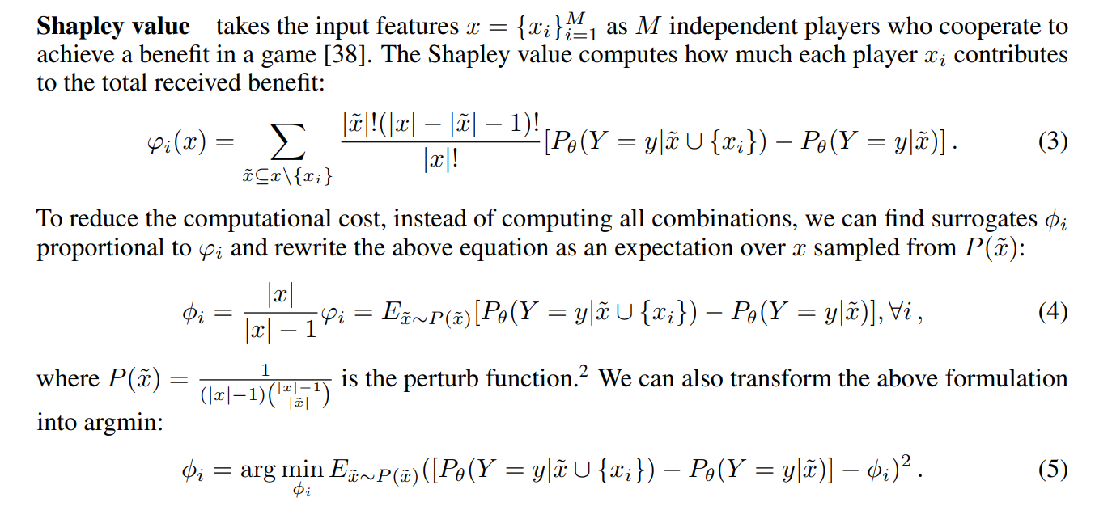
Local Explanation

Slide 5

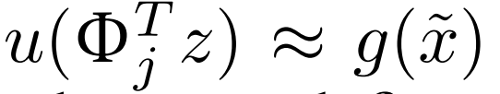
Formulation of Local Explanation
Given response y = y1y2..yN, input x = x1x2..xM, a trained generation model f
Use a explanation model to explain the prediction
Sample perturbed inputs x’ from a distribution centered on the original inputs x
Optimize the explanation model by
z is the one-hot representation of x’
G is the gain function of the generation model f

Slide 6
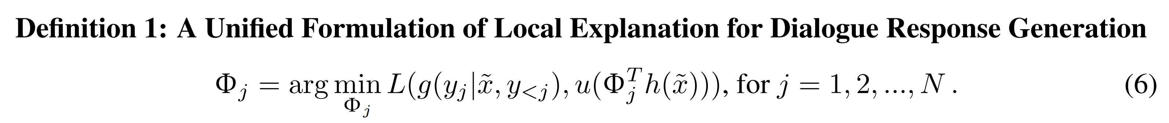
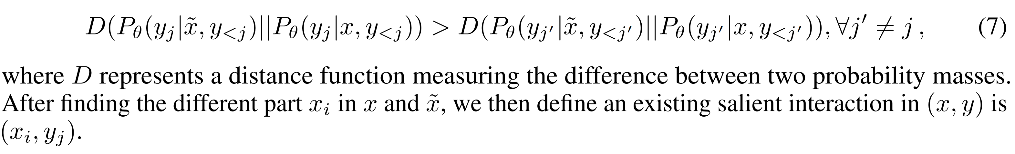
Formulation of Local Explanation

Slide 7
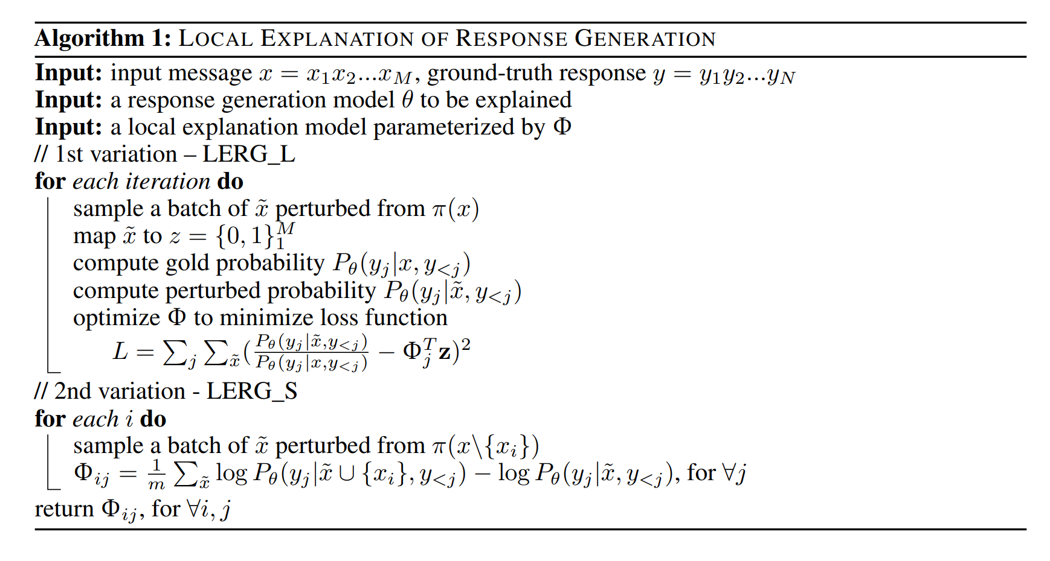
Learning Process of Local Explanation

Slide 8
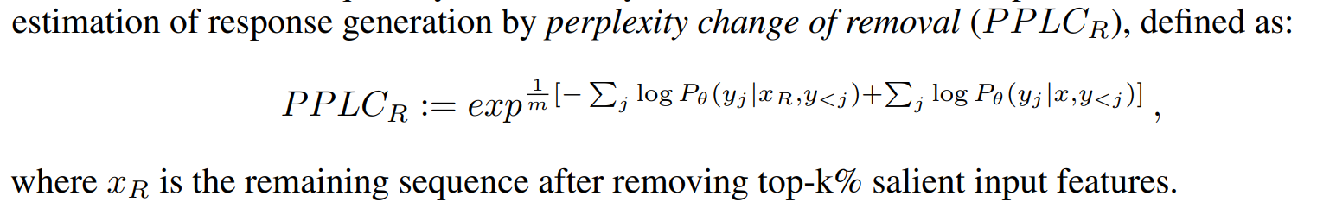
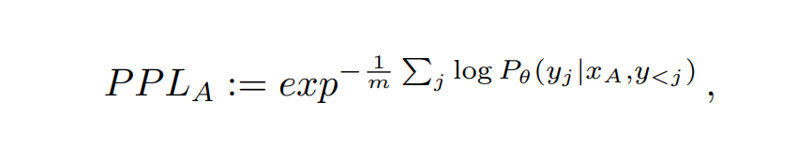
Evaluation
Metric
Necessity: how is the model influenced after removing explanations?
Sufficiency: how does the model perform when only the explanations are given?

Slide 9
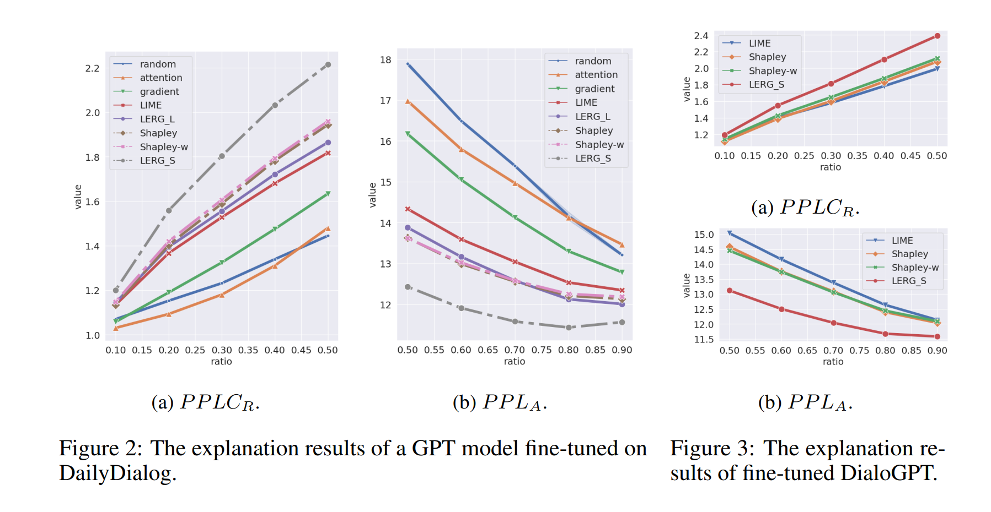
Results

Slide 10
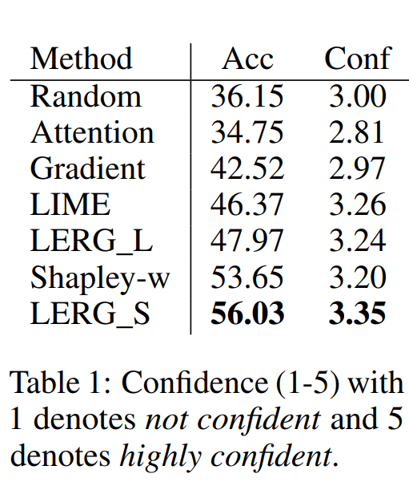
Results of User Study

